Slide 1
PC613: Communication Skills
Sem I, MSc IT
Instructor: Dr. Jenson Joseph

Slide 2
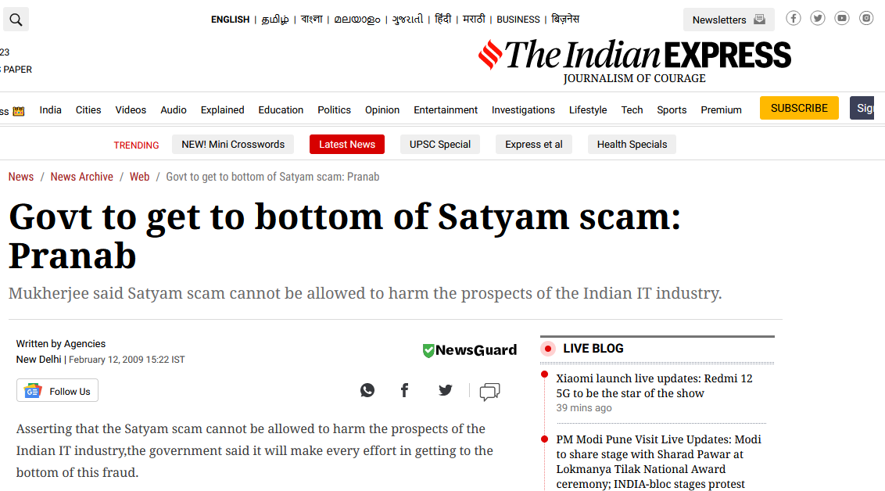
Learn an idiom
“to get to the bottom
of (something)”

Slide 3

Learn an idiom
“to get to the bottom
of (something)”

Slide 4

Learn an idiom
“to get to the bottom
of (something)”

Slide 5
Learn an idiom
“to get to the bottom of”
to find out the true reason for, or cause of, (something);
to discover the truth about a situation
Examples:
The TV reporter has been working on the story, trying to get to the bottom of it, by trying to talk to victims.
A crisis meeting has been scheduled to try and get to the bottom of the company’s inability to perform well.
I'm not sure what is causing the problem, but I'm determined to get to the bottom of it.
My team is trying to get to the bottom of what went wrong.

